Slide 1
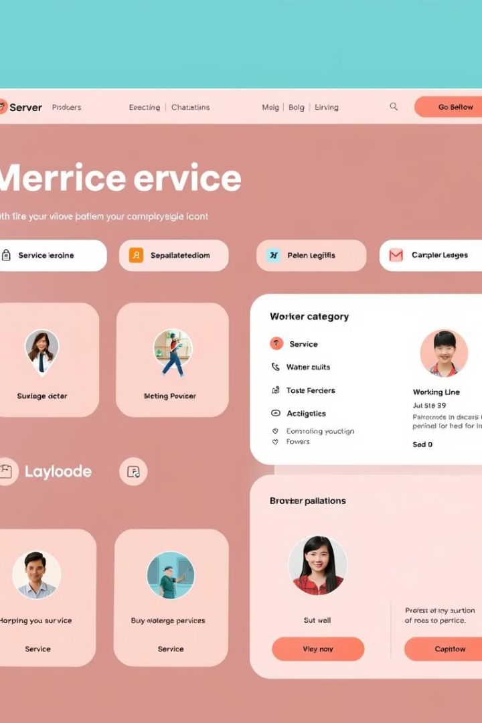

WorkConnect: Revolutionizing Service Hiring
Connecting skilled workers with service seekers.

Slide 2
Platform Overview
User-Friendly Interface
Diverse Service Categories
Verified Worker Profiles
Intuitive search and booking process.
Ensuring quality and trust for clients.
From home maintenance to specialized industry jobs.

Slide 3

Development Milestones: Phase 1
1
Market Research
Identify target audience and competitor analysis.
2
Platform Design
Create user interface and experience wireframes.
3
MVP Development
Build core features for minimum viable product.

Slide 4

Development Milestones: Phase 2
1
Beta Testing
Launch beta version to select users.
2
Feedback Integration
Implement improvements based on user feedback.
3
Full Launch
Official release of WorkConnect platform.

Slide 5

Development Milestones: Phase 3
1
Expansion
Add new service categories and features.
2
Mobile App Development
Launch dedicated iOS and Android apps.
3
AI Integration
Implement smart matching algorithms for better connections.

Slide 6





Key Features
Advanced Search
Filter by skills, location, and availability.
Rating System
Transparent feedback for quality assurance.
Scheduling
Integrated calendar for efficient booking.
Secure Payments
Protected transactions for both parties.

Slide 7

Market Potential
Growing Gig Economy
Digital Transformation
Capitalize on rising freelance workforce trends.
Meet increasing demand for online service platforms.
Cross-Industry Appeal
Global Scalability
Attract diverse range of service providers.
Expand to international markets with localized features.

Slide 8




Investment Opportunity
Seed Funding
Series A
Series B
Initial capital for MVP development.
Scale operations and enhance platform features.
Expand market reach and integrate advanced technologies.

